Slide 1
Algoritma & Pemrograman
Using Functions and Classes
Prepared by
Frans Panduwinata, S.Kom, M.T

Slide 2
Declaring Functions
Each name (identifier) occurring in a program must be known to the compiler or it will cause an error message.
Each time a variable or a function is defined it is also declared.
A function has a name and a type, much like a variable.

Slide 3
Declaring Functions (cont)
The function’s type is defined by its return value, that is, the value the function passes back to the program.
In addition, the type of arguments required by a function is important.

Slide 4
Function Prototype
When a function is declared, the compiler must therefore be provided with information on
  The name and type of the function and
  The type of each argument.
This is also referred to as the Function Prototype.

Slide 5
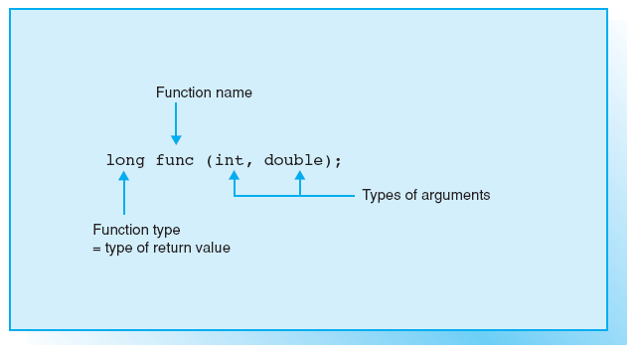
Function Prototype (cont)

Slide 6
Function Prototype (cont)
EXAMPLES Functions Prototype:
int toupper(int);
double pow(double, double);
EXAMPLES Functions:
int toupper(int c);
double pow(double base, double exponent);

Slide 7
Function Prototype (cont)
If the header file is included in the program’s source code by means of the #include directive, the function can be used immediately.
EXAMPLES :
#include <cmath>
Following this directive, the mathematical standard functions, such as sin(), cos(), and pow(), are available.

Slide 8
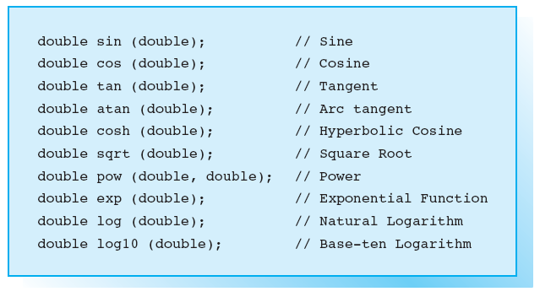
Mathematical Standard Functions

Slide 9
Function Calls
A Function Call is an expression of the same type as the function and whose value corresponds to the return value.
EXAMPLE:
y = pow( x, 3.0);
EXAMPLE:
cout << 2.0 + pow( 5.0, x);

Slide 10
Function Calls (cont)
The compiler refers to the prototype to check that the function has been called correctly.
If the argument type does not match exactly to the type defined in the prototype, the compiler performs type conversion, if possible.
EXAMPLE:
y = pow( x, 3); // also ok!, actually function expects a
// double value,

Slide 11
Function Calls (cont)
EXAMPLE :
float x = pow(3.0 + 4.7); // Error!
The compiler recognizes that the number of arguments is incorrect. In addition, the compiler will issue a warning, since a double, i.e. the return value of pow(), is assigned to a float type variable.

Slide 12
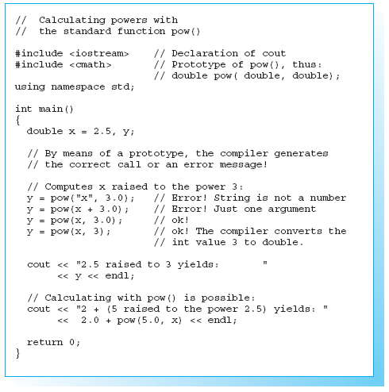

Sample Program

Slide 13
Functions without Return Value
The type void is available for functions that perform a certain action but do not return a value to the function that called them.
EXAMPLE:
void srand( unsigned int seed );
The function srand() is used to generates random numbers.
An unsigned value is passed to the function as an argument to seed the random number generator.

Slide 14
Functions without Arguments
If a function does not expect an argument, the function prototype must be declared as void or the braces following the function name must be left empty.
EXAMPLE:
int rand( void ); // or int rand();
The standard function rand() is called without any arguments and returns a random number between 0 and 32767.

Slide 15
Usage of srand() and rand()
The function prototypes for srand() and rand() can be found in both the cstdlib and stdlib.h header files.
Calling the function rand() without previously having called srand() creates the same sequence of numbers.
You must call srand() with a different value for the argument whenever the program is run.

Slide 16
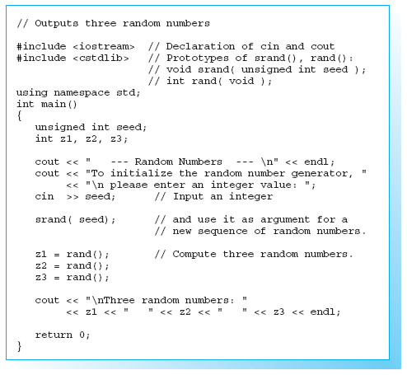
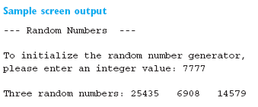
Sample Program

Slide 17
Using Header Files
Pay attention to the following points when using header files:
  Header files should generally be included at the start of a
  program before any other declarations
  You can only name one header file per #include directive
  The file name must be enclosed in angled brackets < ... > or double quotes " ... ".

Slide 18
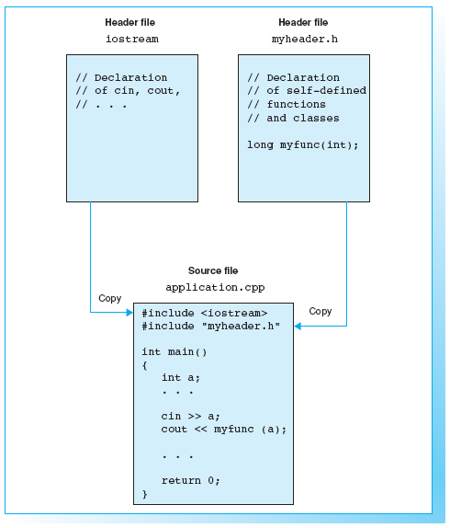
Using Header Files (cont)
angled brackets < ... >, search for
header files in the include folder only.
double quotes, search for current
project folder.
EXAMPLE:
#include "project.h"

Slide 19
Standard Class Definitions
The header files also contain standard class definitions.
When a header file is included, the classes defined and any objects declared in the file are available to the program.
EXAMPLE:
#include <iostream>
using namespace std;
cin is an object of the istream class and cout an object of the ostream class.

Slide 20
Standard Class Definitions (cont)
EXAMPLE without namespace:
#include <iostream>
int main ()
{
std::cout << "Hello world!\n";
return 0;
}
EXAMPLE with namespace:
#include <iostream>
using namespace std;
int main ()
{
cout << "Hello world!\n";
return 0;
}

Slide 21
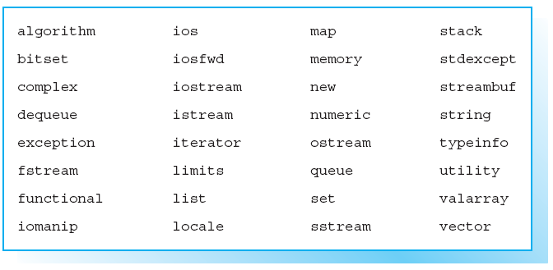
Header Files of the C++ Standard Library

Slide 22
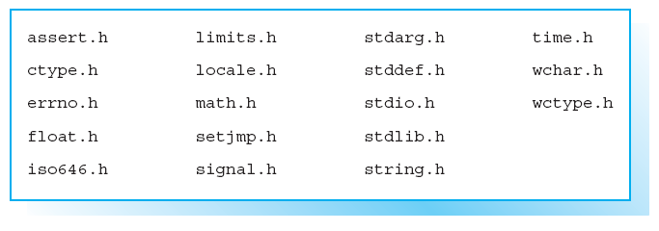
Header Files of the C Standard Library

Slide 23
Using Standard Classes
Several classes are defined in the C++ standard library.
These include stream classes for input and output, but also classes for representing strings or handling error conditions.
Each class is a type with certain properties and capacities.

Slide 24
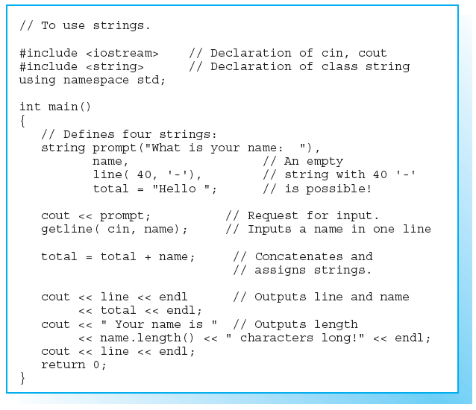
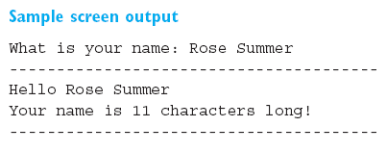
Sample Program Using Class string

Slide 25
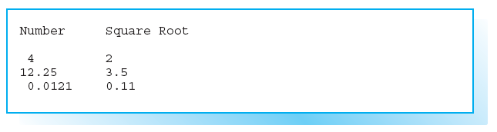
Exercises
EXERCISE 1
Create a program to calculate the square roots of the numbers
4 12.25 0.0121
and output them as shown below. Then read a number from the keyboard
and output the square root of this number.
To calculate the square root, use the function sqrt(), which is defined by the
following prototype in the math.h (or cmath ) header file: double sqrt( double x);

Slide 26
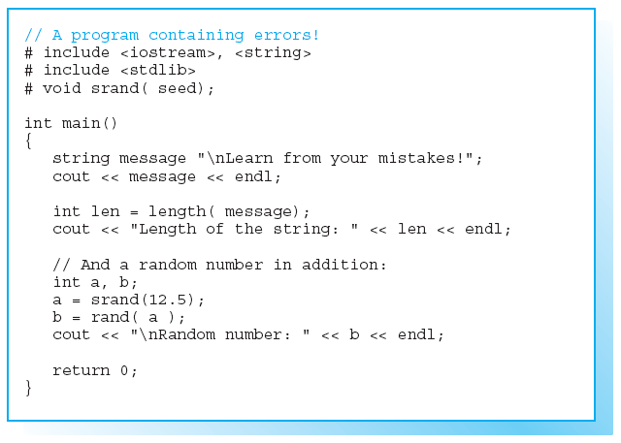
Exercises (cont)
EXERCISE 2
The program shown
side contains several
errors!
Correct the errors and
ensure that the program
can be executed.

Slide 27
Exercises (cont)
EXERCISE 3
Create a C++ program that defines a string containing the following
character sequence:
I have learned something new again!
and displays the length of the string on screen.
Read two lines of text from the keyboard.
Concatenate the strings using " * “ to separate the two parts of the string.
Output the new string on screen.

